Slide 1
Setting the Stage for ESPA Membership

Slide 2
ESPA’s Mission Statement
ESPA is dedicated to elevating the event and convention service profession and to preparing members, through education and networking, for their pivotal role in innovative and successful event execution.
The only association focused on the Services professional!

Slide 3
ESPA’s Mission
Benefits fall into these main buckets:
Services and events industry education
Networking and relationship building for service professionals
Bringing awareness of the role of the services professional within the events community

Slide 4
ESPA’s Mission
Services and events industry education

Slide 5
Webinars
Bringing education to YOU at your office or facility
Topics are planned by Continuing Education Committee with a goal to be beneficial to CSMs from all disciplines
ESPA is a CMP Preferred Provider
You get 1 continuing education contact hour for each CMP approved webinar – that means up to 10 hours that can be earned just from webinars
Webinar Packages available at discounted rates

Slide 6
Annual Conference - What education will you experience?
2 days of education catered to the unique and challenging role that Event Service Managers play every day. We want to help you be the best CSM that you can be.
Continuing Education credits! Our program will provide you with valuable credits towards your CMP requirements
A learning session with meeting planners – On Sunday you have an opportunity to get your questions answered direct from planners!
January 5-7, 2018 – are you going to join us?
(Just prior to PCMA Conference)

Slide 7
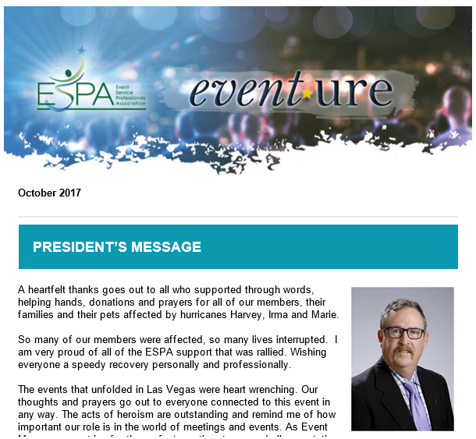
ESPA Communications
Monthly event*ure – Info pertinent to CSMs
Event Trends, Services Tools, Member News, Planner and Member Spotlights

Slide 8
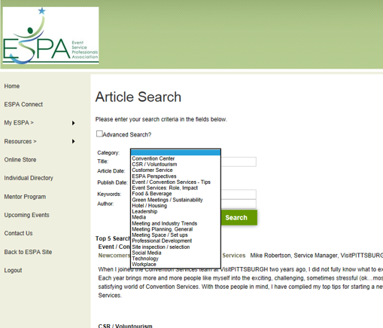
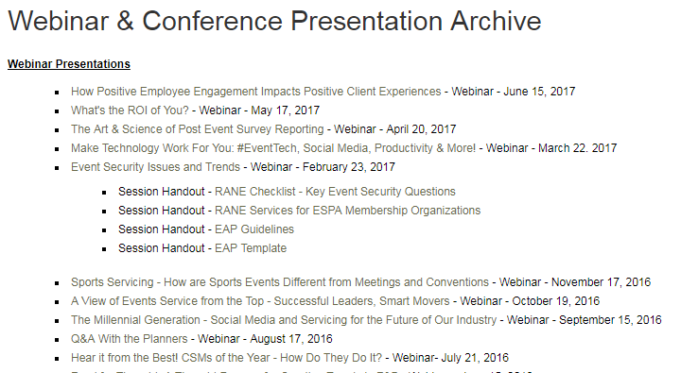
Website Resources
Article Archive
Searchable Member Directory
Recorded Webinar Archive
Event Details
Your Continuing Education credits
Toolbox
Accessibility FAQs – a customizable resource guide to showcase your destination’s accessibility

Slide 9
ESPA’s Mission
Networking and relationship building for service professionals

Slide 10
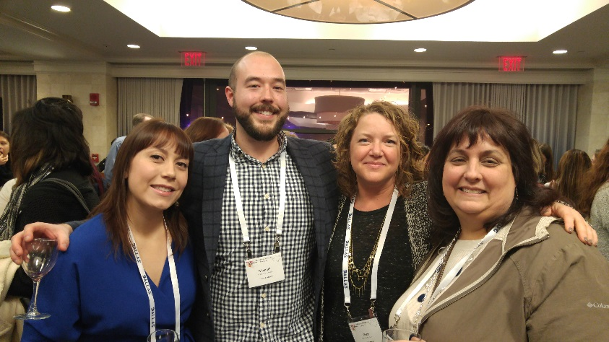
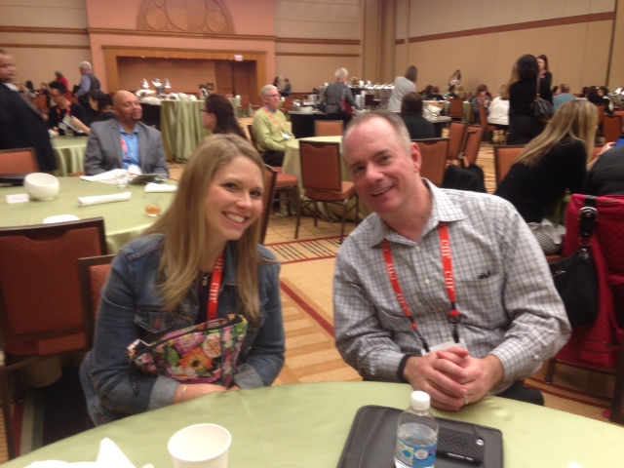
Annual Conference - What will you experience with Networking?
Fun and engaging opportunities are abundant!
Collaboration Centers – to meet fellow CVB, Center or Hotel members
Dine-Arounds
Ice breakers
Each and every year, ESPA attendees report back on the amazing and long-lasting networking connections they have made.
Attendees create life-long professional relationships with other CSMs who teach and inspire them, becoming a resource in their day to day professional careers.

Slide 11
ESPA established this week of celebration for a few primary reasons:
To create a week aimed at getting local CSMs together...to encourage camaraderie locally and be a springboard for future local gatherings
To celebrate what we do! Being a key partner with meeting planners for making great meetings happen. That’s cause for celebration in and of itself
To grow our ESPA ranks. This is a great week to bring new CSMs into the ESPA mix – invite prospects and let them know about ESPA.
ESPA sets the date and the theme. You do what you do best – host a local event!
This year’s theme was We’re all about Service, focused around community service.

Slide 12
ESPA Connect
A members-only online community which enables members to network all year long
Connect with your fellow members by joining discussion groups
Post questions to get advice from peers
Post resources to share with members
Create and participate in surveys
Access the members-only directory

Slide 13
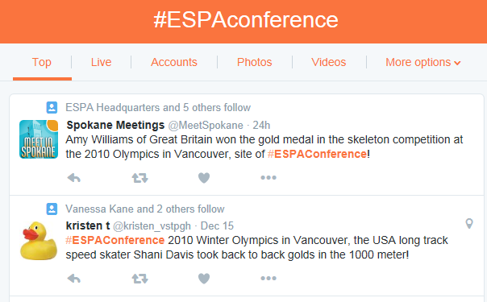
ESPA Social Media – join the conversation

Slide 14
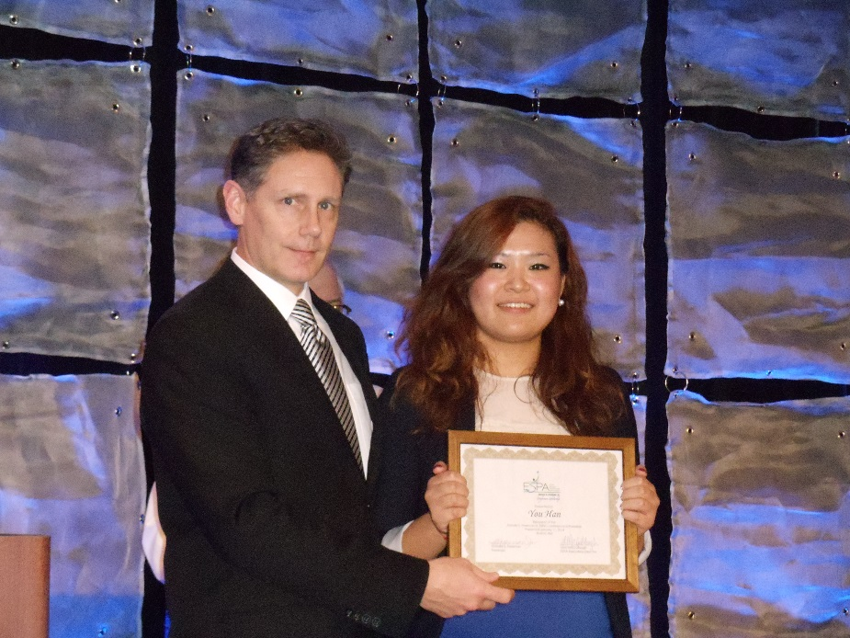
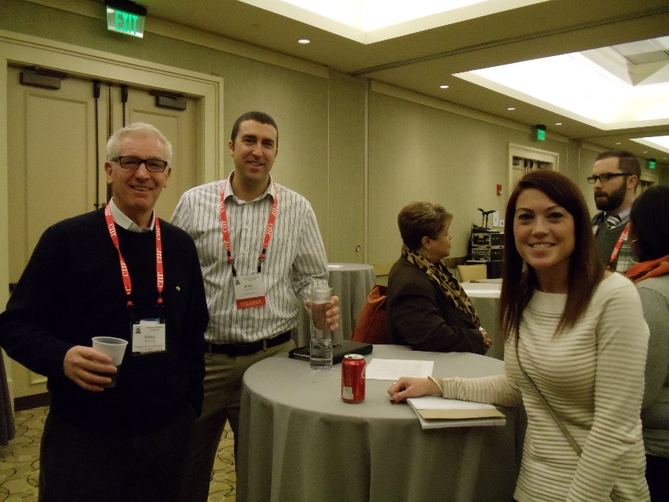
Mentor/Mentee Program
An experienced CSM is partnered with a new or Junior CSM
Mentors: Objective is to be an accessible go-to resource for a mentee, giving guidance, offering solutions or ideas
Meet and collaborate at the Conference
Have ongoing communications via email or phone calls

Slide 15
Committees A great way to network with fellow members
Marketing
Continuing Education
Annual Conference

Slide 16
ESPA’s Mission
Bringing awareness of the impact of the services professional in the events community

Slide 17
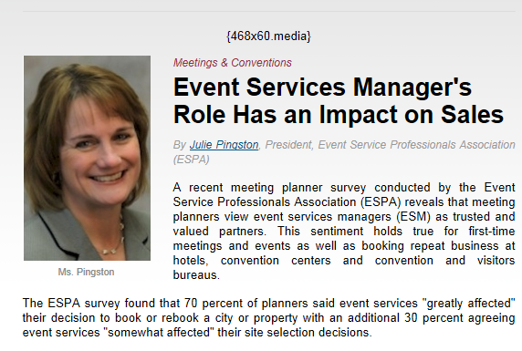
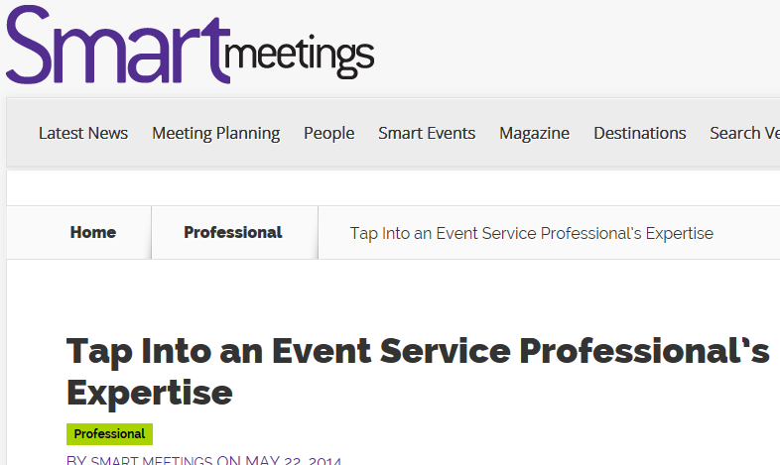
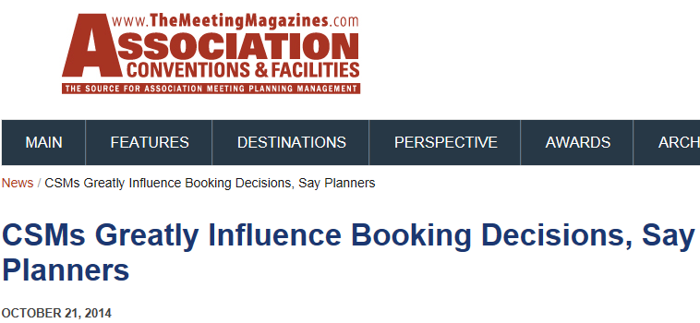
Public Relations Advocating for the Event Service Role

Slide 18
Bringing awareness of the services professional within the events community
PR and Social Media to emphasize the value of education for CSMs
Flyer available on ESPA web site – Use it to gain approval to attend the Conference or to recruit fellow CSM peers

Slide 19
Member Recognition & Scholarship Opps
CSM of the Year
Successful Meetings' Convention Services Manager of the Year award winners have demonstrated to the most demanding critics in the business - meeting planners - their ability to provide the highest level of service.
Executive Excellence Award
ESPA recognizes an executive for his or her commitment and dedication to the profession of event service and to giving key support and leadership to members of their services team. ESPA members submit nominations for executives who support ESPA and are convention services advocates.
Meeting Professional of the Year
This award was designed to recognize the hard-working meeting professional who exhibits personal and professional characteristics that create an environment that focuses on team work, as well as shows support for the event services profession.
William H. Just, CAE, CMP Memorial Award
This award recognizes an ESPA member who has received their CMP certification within the last five years. The award was established in honor of the late William H. Just, CAE, CMP who founded ESPA in 1988. Bill Just also played a key role in the establishment of the CMP program.

Slide 20
Recent Initiatives
ESPA Code of Ethics
Event Service Professionals Association (ESPA) presents the following ethics statement to establish and promote the professional behaviors we feel are vital to our work in the hospitality business…
Accessibility FAQ
This template is available as a part of the ESPA online toolkit, and was developed with the input meeting planners and our members.
Security Initiative
ESPA is currently in development of a document to aid members in security conversations with planners.
These are Great Opportunities for Member Involvement and Leadership

Slide 21
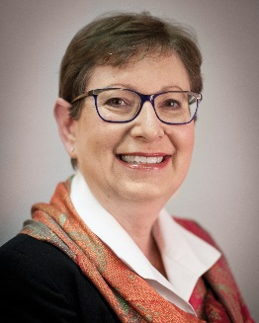
In the Words of an ESPA Past President
…Will there ever be a better time than right now to invest in your professional development…your future? I call upon each of us to commit to growing ESPA and our footprint in the meetings industry… through education, friendship and innovation.
Sincerely,
Denise Suttle, CMP ESPA Past-President

